Slide 1
Estimations of Dust Yields from AGB Stars within Dusty Star Forming Galaxies
Tiara Anderson | Lauryn E. Williams

Slide 2
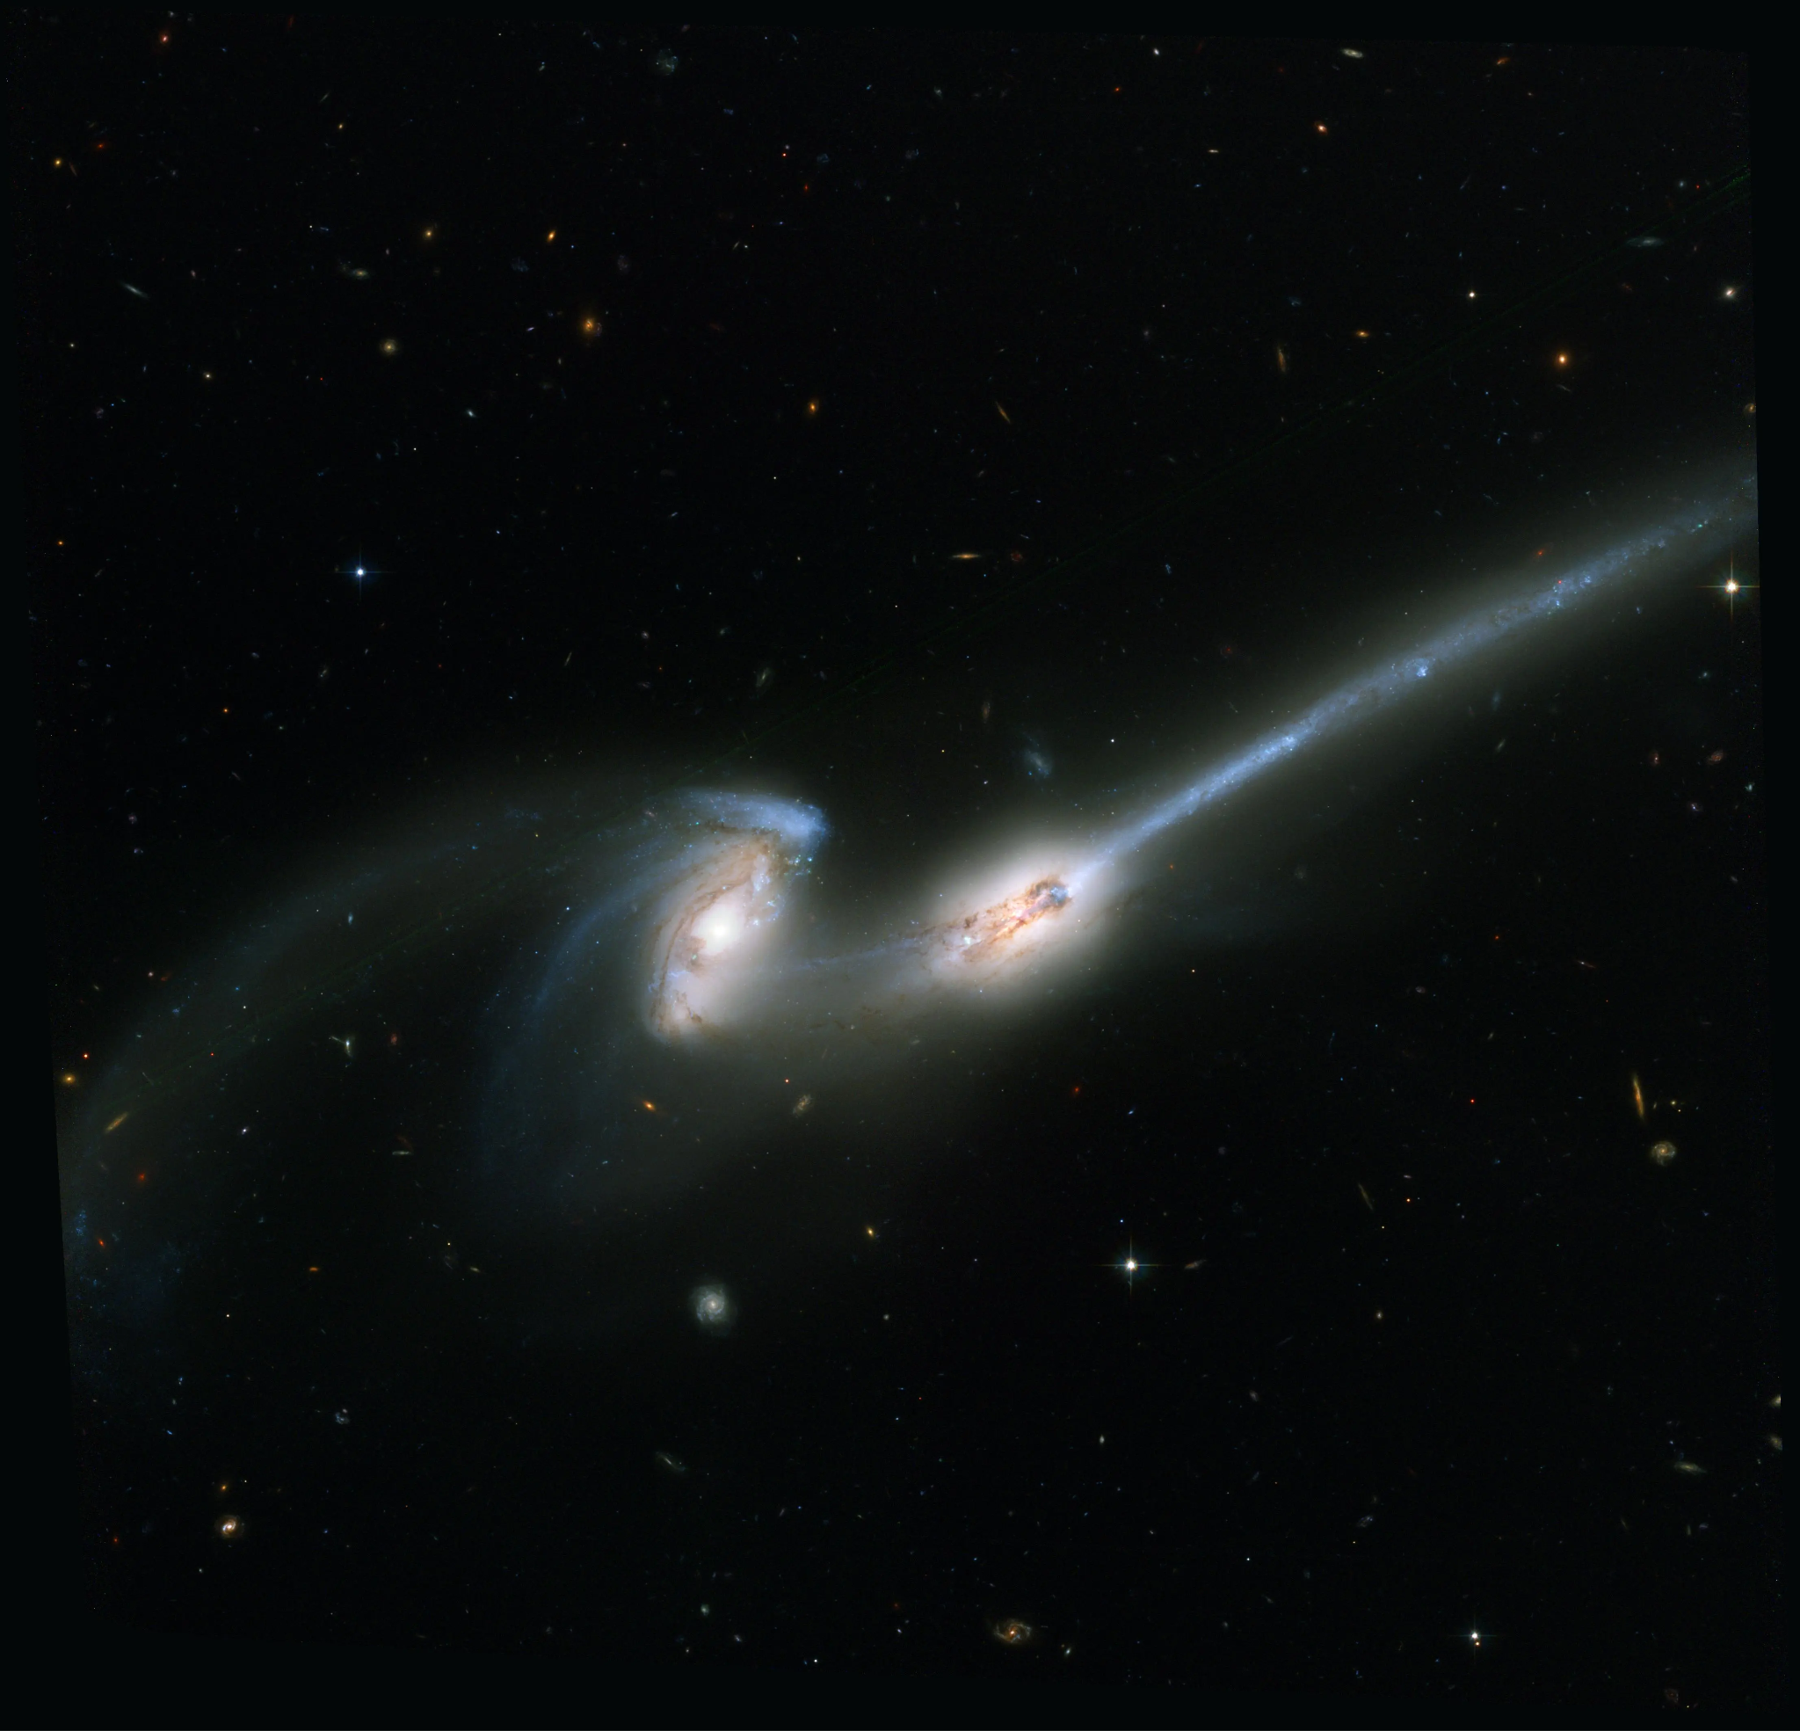
DSFGs
Dusty star forming galaxies are massive galaxies that form 100s-1000s of stars per year
  Most of these galaxies formed 2 billion years after the Big Bang, the peak of galaxy and star formation
The formation of these galaxies varies from mergers, to AGN, inflows, etc.
  These processes aid in the increased dust reservoirs we see
The form and structure (morphology) of these galaxies can guide us in understanding how they might have formed
NASA, H. Ford (JHU), G. Illingworth (UCSC/LO), M. Clampin (STScI), G. Hartig (STScI), the ACS Science Team, and ESA
Notes:
when i reference abundances im referring to the amount of that element within a star…

Slide 3
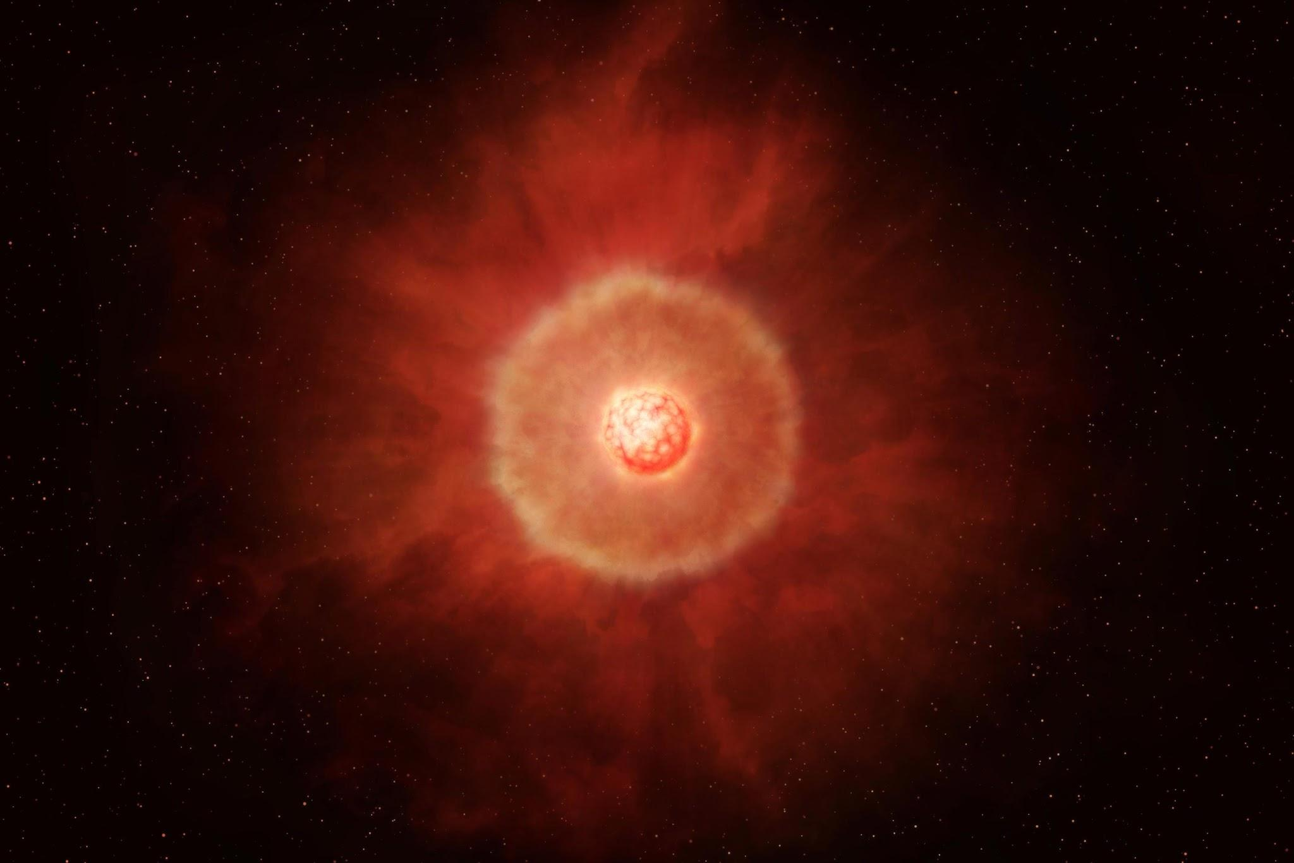
AGB Stars
Asymptotic giant branch (AGB) stars are very cool, but luminous stars.
These stars have high rates of mass loss and are the major contributors to the chemical composition of the universe
scitechdaily.com
Notes:
when i reference abundances im referring to the amount of that element within a star…

Slide 4
The overall aim of the project is to estimate how much dust within DSFGs is coming from AGB stars
  The project will focus on interpreting the physical parameters of DSFGs in the SCUBADive sample and what that means for the galaxy’s physical properties. Using MESA and the data from SCUBADive, we will be able to replicate the ages/compositions of AGB stars and model their contribution to the DSFGs.
This project is a combination of observation and theory, you’ll be working with real astronomical data to help in the effort to uncover these mysterious objects!
Project Goal:

Slide 5
Data and Methodology
SCUBADive: a catalogue of DSFGs detected by JWST (launched in 2021) that exhibit similar quantitative characteristics (redshift, stellar mass, attenuation, etc.) but vary in morphologies
MESA: A powerful and flexible stellar evolution code that tracks a variety of stellar processes
We’ll be using data from SCUBADive and modeling techniques from MESA to understand:
  How much mass loss from the AGB stars is contributing to the dust content within DSFGs
Will gain skills in python, MESA, matplotlib, fortran, and more!

Slide 6
Outcomes and Conclusion
There is an importance of understanding the dust content within DSFGs and the many things that can add to it
Understanding the major dust contributors has implications for other galactic processes driving the evolution of the universe!

